Slide 1
Sea Turtles
Focusing on the Loggerhead and Green Turtle Species
Group 7
Amanda Duong
Ketong Zhang
Jasmine Hsiao

Slide 2
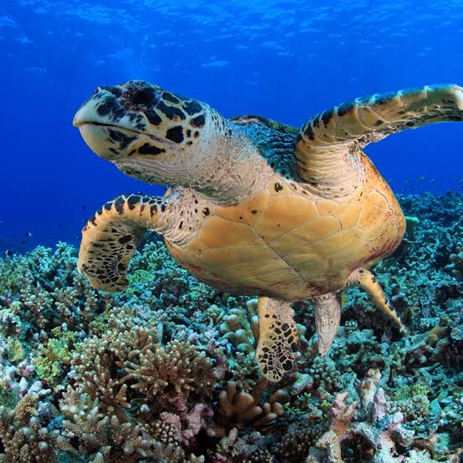
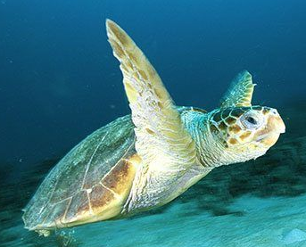
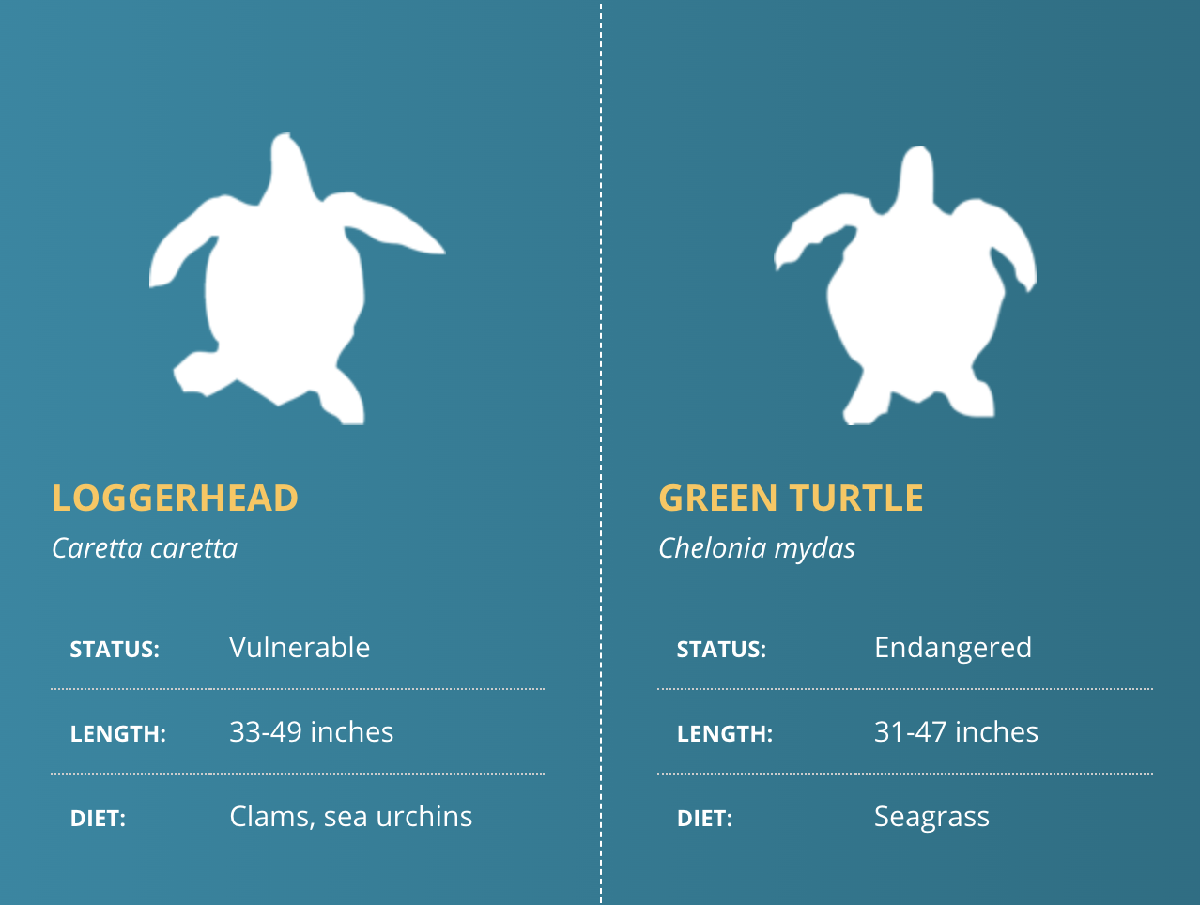
Introduction
Sea turtles have faced a sharp decline in recent decades.
There are 7 species of sea turtles that live in our oceans – most are endangered.
All sea turtles in US waters listed as either threatened or endangered under the Endangered Species Act
Florida has one of the highest sea turtle populations/nesting sites in the US
(World Wildlife)
Notes:
Sea turtles have faced a sharp decline in recent decades due to habitat loss and climate change.
We mainly focused on loggerhead and green sea turtles because they are vulnerable species
We focused most of our analysis on Florida as it has one of the highest sea turtle populations/nesting sites in the US and their population is also largely endangered due to coastal development

Slide 3
Data
Used four datasets:
A Sea Map dataset representing global nesting sites
Green sea turtle dataset
Loggerhead sea turtle dataset
Sea turtle strandings in Florida
Data was mostly tidy
(units in their cells)
Minimal cleaning to fix variables/columns

Slide 4
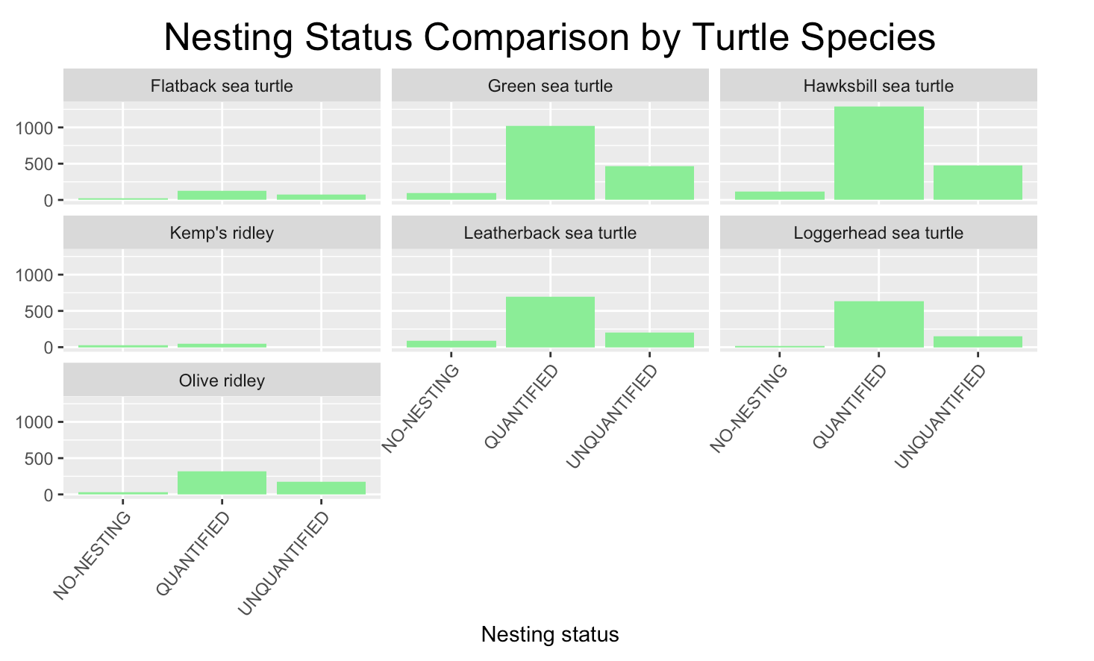
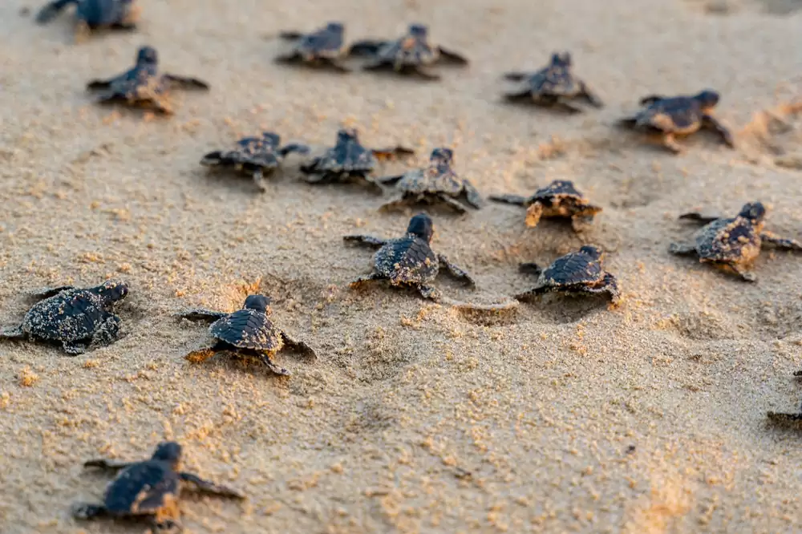
Sea Map
What are the nesting statuses based on turtle species?
I
Notes:
we first look at the nesting status over the 7 turtle species globally, there we found quantified nesting status are the highest type of status
quantified generally include nesting counts, distribution, success rate and trend

Slide 5
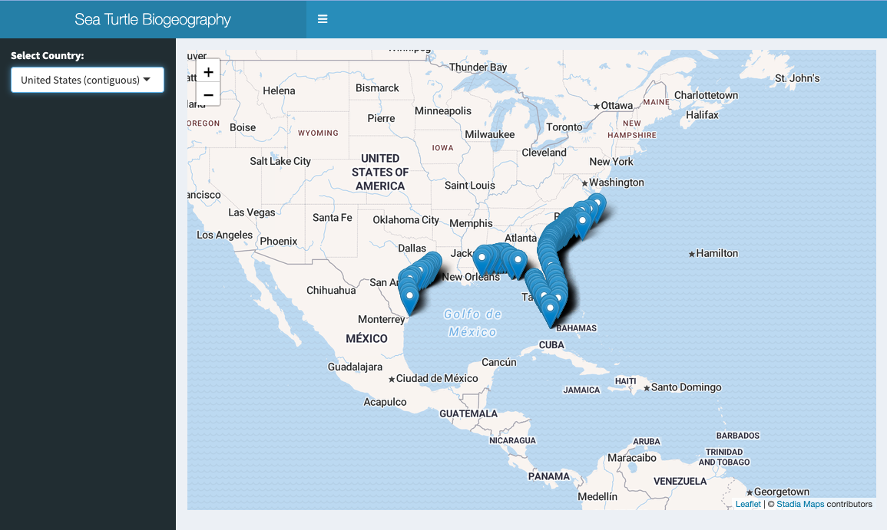
Sea Map - Shiny App
Visualize global sea turtle biogeography by country and region
Notes:
Choose what country you want to visualize
Zoom in or out to view different sites

Slide 6
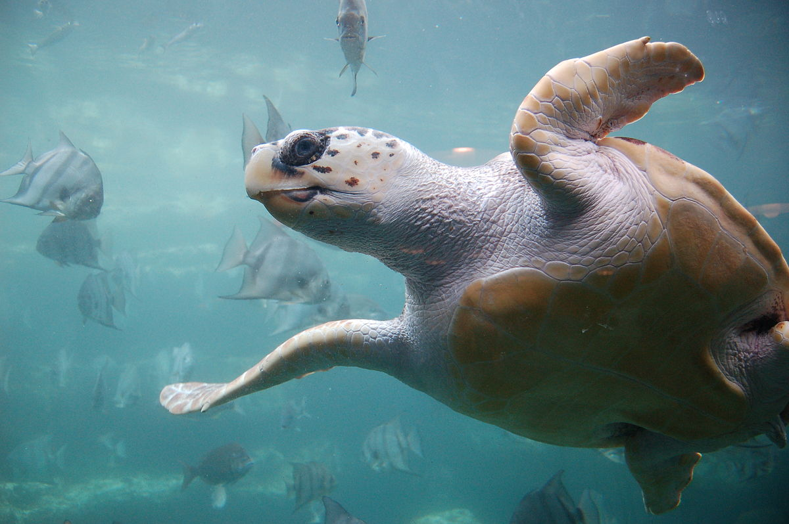
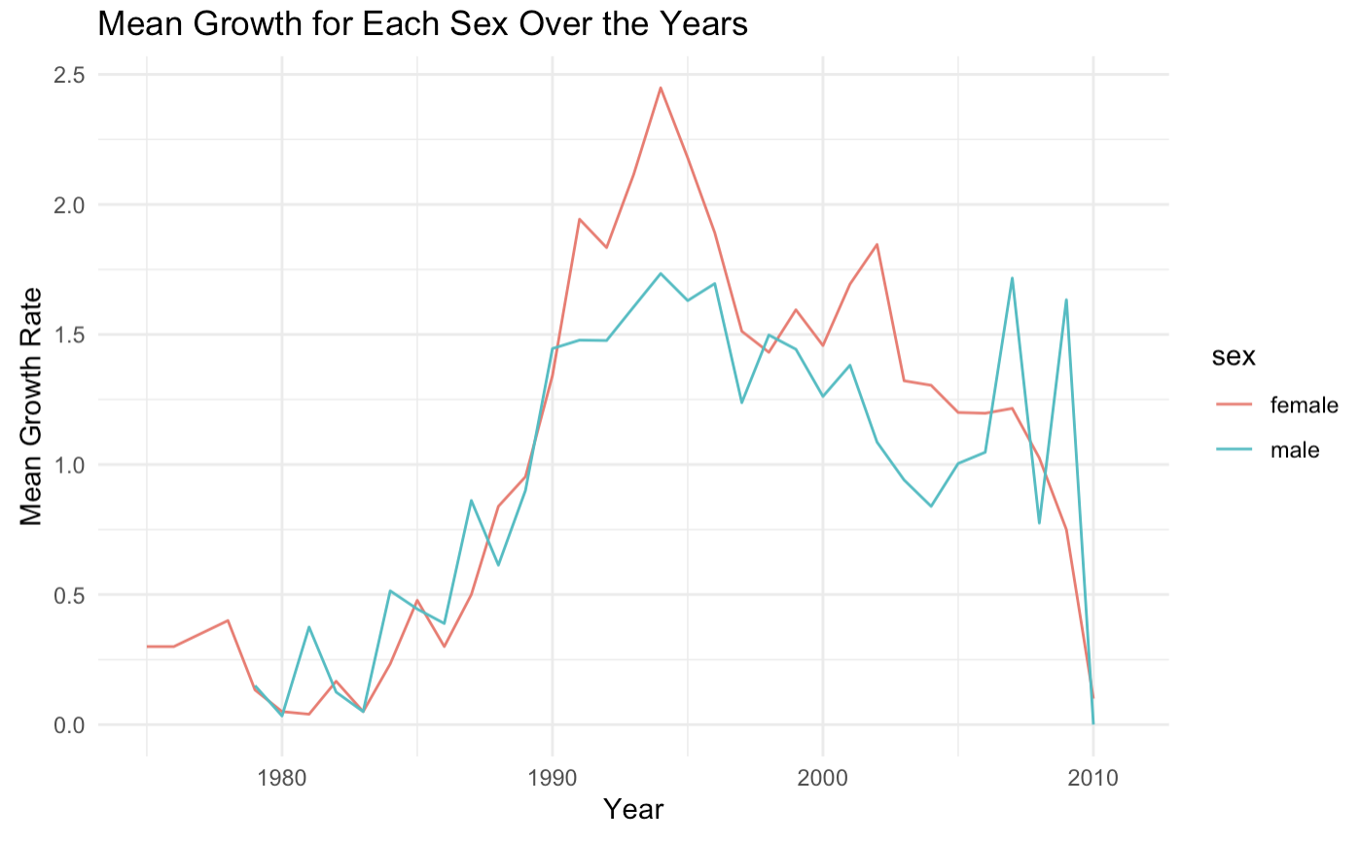
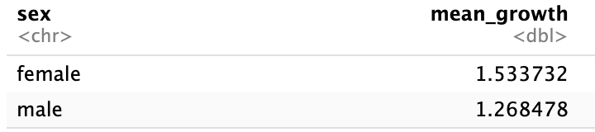
Loggerhead Sea Turtles
Do males or females tend to grow faster over time?
1980-1990: gradual increase with a sharp increase in growth around 1990
Both males and females peak in size around 1994
Overall, females tend to grow in size faster
Notes:
This dataset viewed turtle size and age given by analysis of skeletal growth in loggerhead sea turtles collected along the US Atlantic Coast.
The rapid growth of females may result in overall decline in loggerhead population because their male counterparts cannot keep up

Slide 7
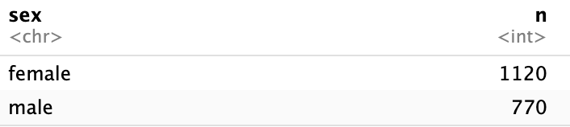
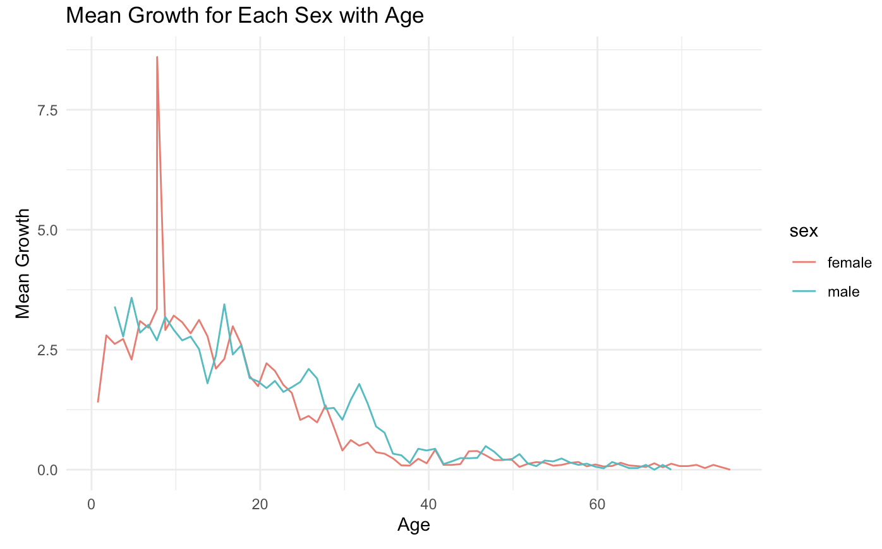
Loggerhead Sea Turtles
At what age do males or females tend to grow the most?
There are more females than males in the data.
The average growth rate for females peaks at around 10 years old.
Females also decline in average growth rates faster than males.
Notes:
More females than males in the data -> could be caused by their fast growth rates combined with climate change which is skewing the sex ratio
Additionally, sea turtles don’t have sex chromosomes -> the temperature of their nests determine a turtle’s gender (temperature-dependent sex determination)
This can also result in a decline in the overall loggerhead population
Despite having a higher peak, females also decline in average growth rates faster than males.
The trends of these growth rates are similar to those of green sea turtles

Slide 8

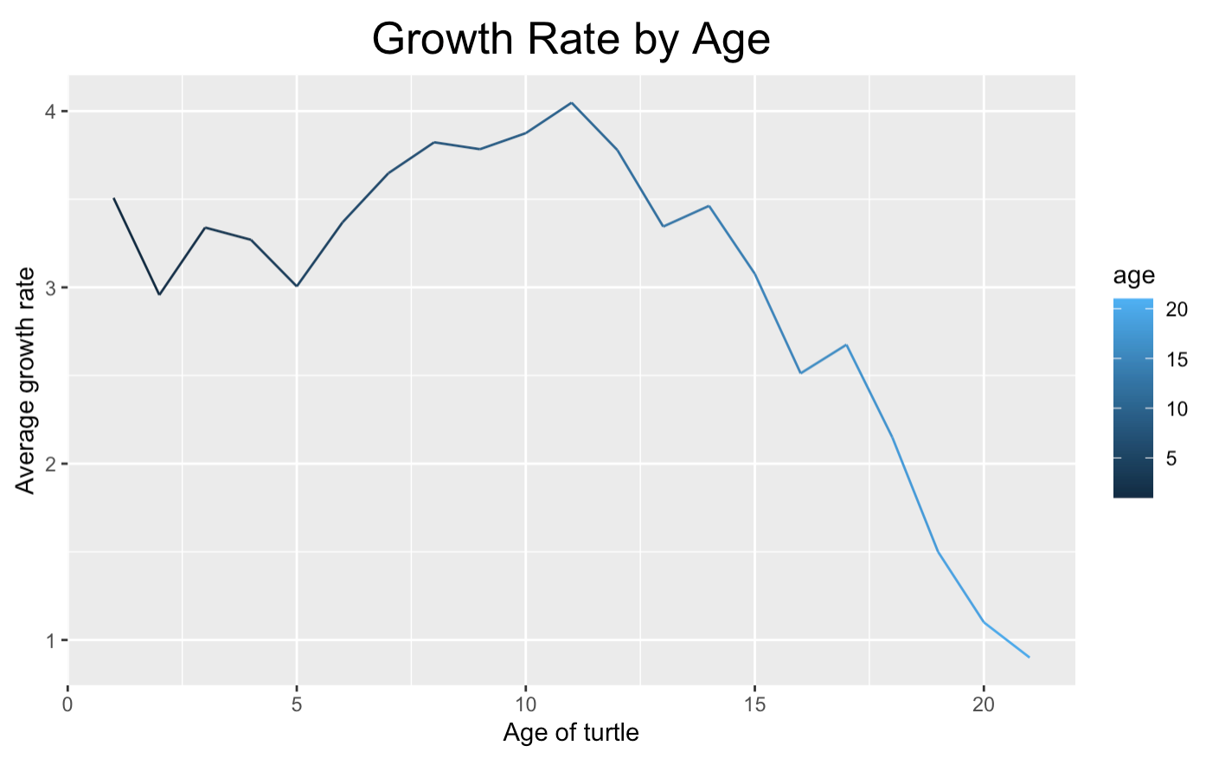

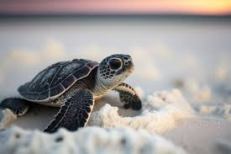
Green Sea Turtles
What is the correlation between growth rate and age?
Positive or negative correlation
Growth from age 5 to 12
Rapid decrease after 12
Notes:
moving on to green sea turtle, we can see a growth between age 5 to 12, and follow by decrease in rate after the age of 12
we assume that around this age, sea turtle started to reach sexual maturity and therefore the energy used for growing will diverge to the development of reproductive activities

Slide 9
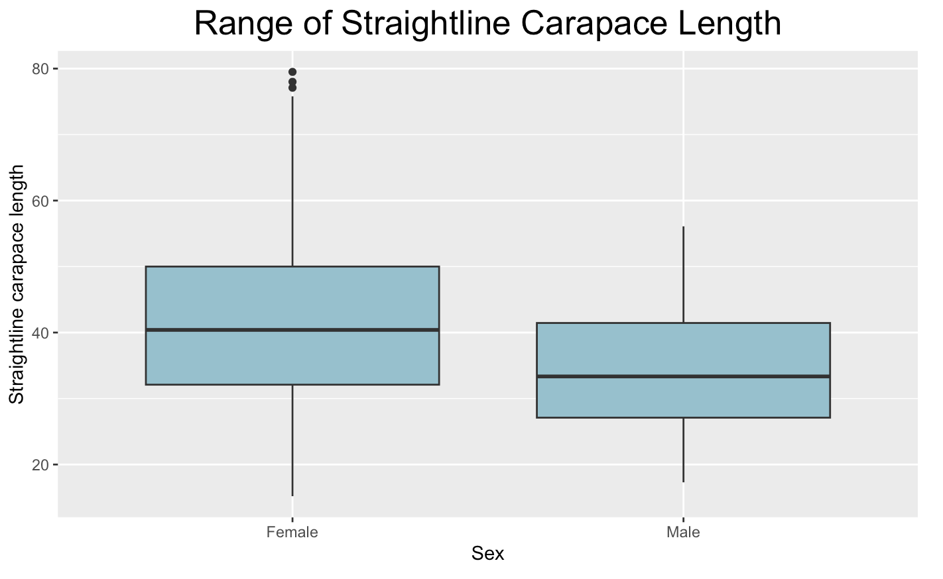

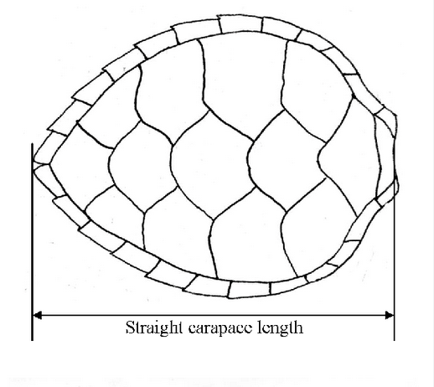
Green Sea Turtles
How to measure a turtle’s carapace
Female turtle
15.20cm - 79.50cm
Male turtle
17.30cm - 56.10cm
Notes:
now looking at the range of carapace length, we see that female turtles have an overall longer carapace length compared to male turtle
possible reason is female turtles need space for their reproductive organs (such as ovaries and eggs) and due to their nesting behavior, they need to dig in the sand to lay the eggs, therefore tend to have a larger body size

Slide 10
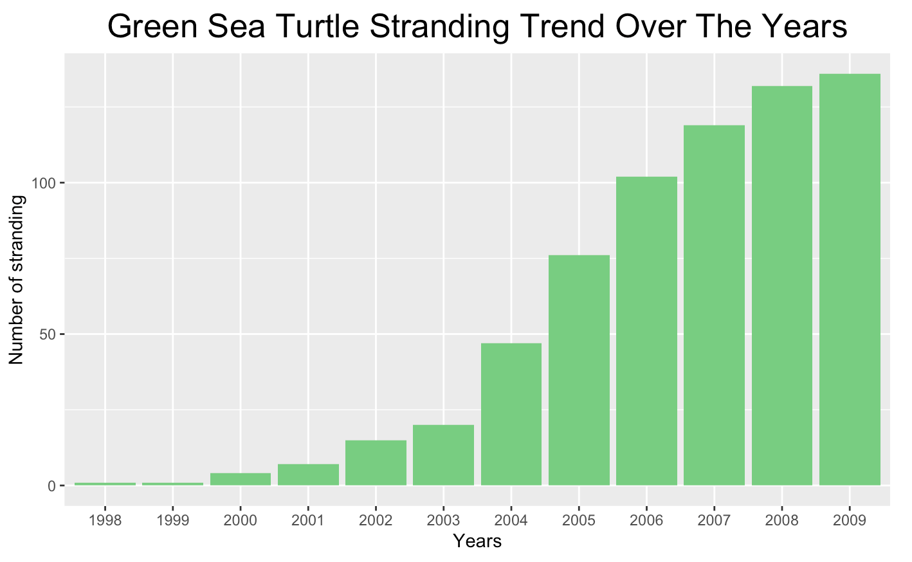
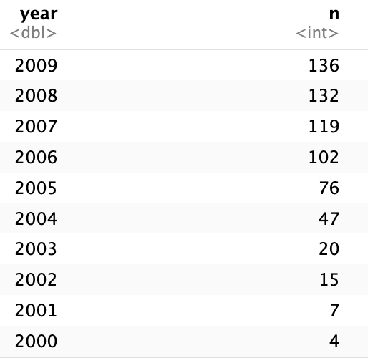
Green Sea Turtles
What years have the highest turtle stranding rate?
Sea turtle stranding possibly increased due to climate change
Notes:
“Stranding" refers to a sea turtle that is either found dead or is alive but is unable to go about its normal behavior due to an injury, illness, or other problem.
Possible reason: sea turtles use both marine and land habitats in their life cycle, the effects of climate change are likely to be devastating to these endangered species. Sea level rise will affect sea turtle nesting locations

Slide 11
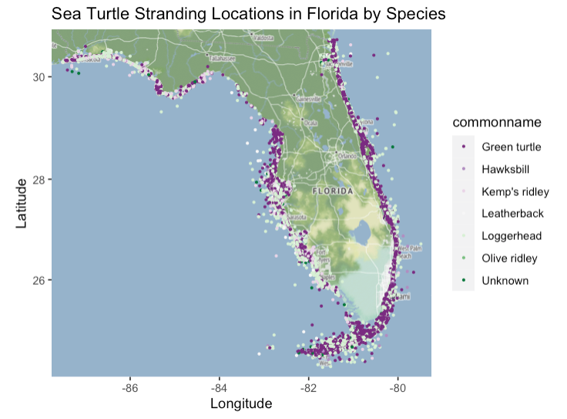
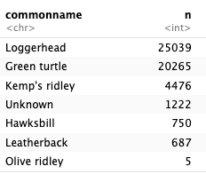
Sea Turtle Stranding Florida
Where are the sea turtle strandings located? What species has the highest total count?
Notes:
Then I did analysis on a dataset on sea turtle stranding in florida.
This map shows where the strandings are located with the highest species stranded being Loggerhead and the second being Green turtle.
https://www.fisheries.noaa.gov/southeast/marine-life-distress/frequent-questions-northern-gulf-mexico-sea-turtle-strandings

Slide 12
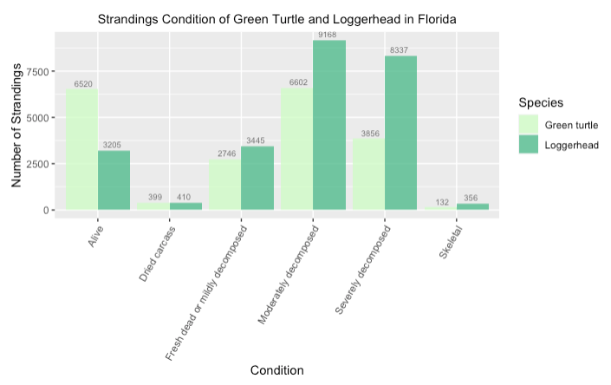
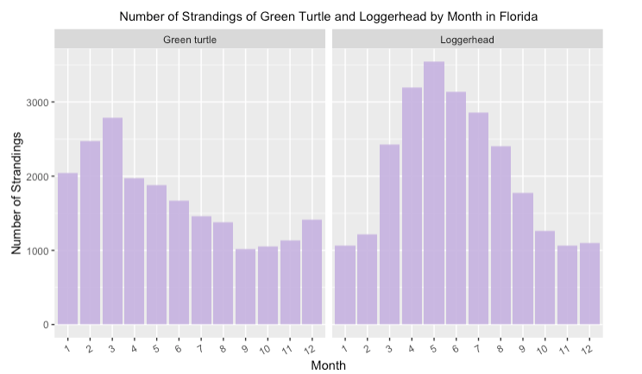
Sea Turtle Stranding Florida
How does the condition of stranding compare between Green Turtle and Loggerhead?
Which month has the highest strandings for the two species?
Higher recorded alive Green Turtle
Higher recorded decomposed Loggerhead
Green Turtle: # strandings peak in March
Loggerhead: # strandings peak in May
Notes:
Two analysis:
One shows that there is higher recorded alive green turtle and decomposed loggerhead.
This could be due to human activities and how nesting females loggerheads are more susceptible to vessel strikes when migrating to nearshore during the nesting season.
Another shows how Green turtle stranding peak in March and loggerhead peak in May.
This could be due to how strandings in the northern Gulf of Mexico tend to increase following winter, continuing through the summer.
While its not completely understood but is likely related to increase in sea turtles as they return to warming inshore waters, interaction with causes of mortality, and winds or currents.
https://www.fisheries.noaa.gov/southeast/marine-life-distress/frequent-questions-northern-gulf-mexico-sea-turtle-strandings
https://www.fisheries.noaa.gov/species/loggerhead-turtle

Slide 13
Conclusion
Turtles fill a vital role in the balance of marine habitats
Florida: extensive sea turtle rehabilitation efforts
Coastal development is the biggest threat to sea turtles in the US
Analysis:
Climate change: skew sex ratios = more females
Female turtles (both loggerhead and green) tend to be larger than males
Sea turtle strandings also peak in the spring
Notes:
The US has the Sea Turtle Stranding and Salvage network as well as tracking in attempts to conserve sea turtles. Specifically, Florida has extensive sea turtle rehabilitation efforts to locate them along the Atlantic coast and release them in warmer waters.
Climate change can change the sex ratios of turtles, resulting in more females as we saw in the data and an overall declining population.
Female turtles also tend to be larger than their male counterparts.
Sea turtle strandings peak in early warm months (March and May); this number will increase over time as it gets warmer earlier in the year due to climate change
Most commonly stranded species are the loggerhead and green sea turtles in Florida.

Slide 14
Sources
Diagram of turtle carapace length: https://www.researchgate.net/figure/Diagrams-of-measurement-points-for-straight-carapace-length-SCL-upper-and-tail-length_fig1_226750530
Sea turtle infographic: www.worldwildlife.org/pages/infographic-sea-turtles
Sea map dataset: seamap.env.duke.edu/
Loggerhead dataset: catalog.data.gov/dataset/adult-loggerhead-turtle-size-age-stage-duration
Green turtle dataset: fisheries.noaa.gov/inport/item/36195
Florida sea turtle stranding dataset: geodata.myfwc.com/datasets/fb5d8030596b4af1b2d63b5782b55a77/about

